Slide 1
Guide to Computer Forensics and Investigations Sixth Edition Chapter 6
Current Digital Forensics Tools
Notes:
Guide to Computer Forensics and Investigations Sixth Edition
Chapter 6
Current Digital Forensics Tools

Slide 2
Objectives
Explain how to evaluate needs for digital forensics tools
Describe available digital forensics software tools
List some considerations for digital forensics hardware tools
Describe methods for validating and testing forensics tools

Slide 3
Evaluating Digital Forensics Tool Needs
Consider open-source tools; the best value for as many features as possible
Questions to ask when evaluating tools:
On which OS does the forensics tool run?
Is the tool versatile?
Can the tool analyze more than one file system?
Can a scripting language be used with the tool to automate repetitive functions and tasks?
Does it have automated features?
What is the vendor’s reputation for providing product support?

Slide 4
Types of Digital Forensics Tools
Hardware forensic tools
Range from simple, single-purpose components to complete computer systems and servers
Software forensic tools
Types
Command-line applications
GUI applications
Commonly used to copy data from a suspect’s disk drive to an image file

Slide 5
Tasks Performed by Digital Forensics Tools (1 of 20)
Follow guidelines set up by NIST’s Computer Forensics Tool Testing (CFTT) program
ISO standard 27037 states: Digital Evidence First Responders (DEFRs) should use validated tools
Five major categories:
Acquisition
Validation and verification
Extraction
Reconstruction
Reporting

Slide 6
Tasks Performed by Digital Forensics Tools (2 of 20)
Acquisition
Making a copy of the original drive
Acquisition subfunctions:
Physical data copy
Logical data copy
Data acquisition format
Command-line acquisition
GUI acquisition
Remote, live, and memory acquisitions

Slide 7
Tasks Performed by Digital Forensics Tools (3 of 20)
Acquisition (cont’d)
Two types of data-copying methods are used in software acquisitions:
Physical copying of the entire drive
Logical copying of a disk partition
The formats for disk acquisitions vary
From raw data to vendor-specific proprietary
You can view a raw image file’s contents with any hexadecimal editor

Slide 8
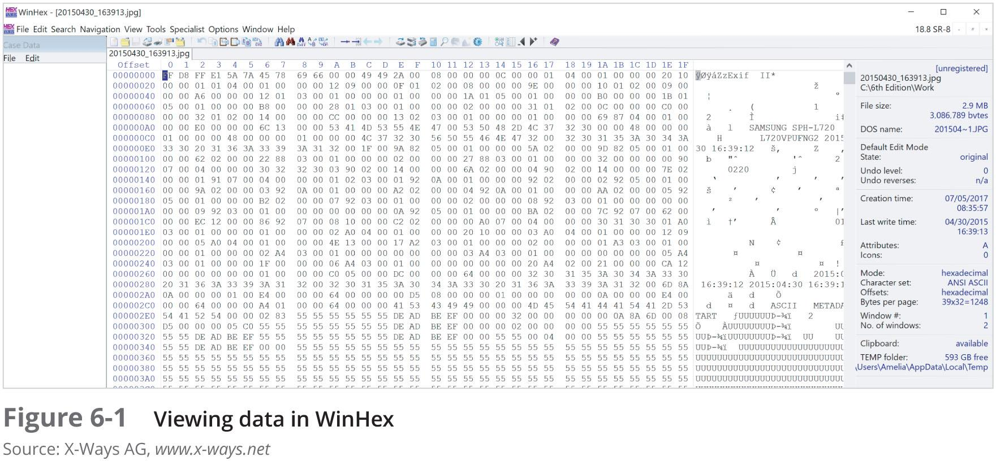
Tasks Performed by Digital Forensics Tools (4 of 20)

Slide 9
Tasks Performed by Digital Forensics Tools (5 of 20)
Acquisition (cont’d)
Creating smaller segmented files is a typical feature in vendor acquisition tools
Remote acquisition of files is common in larger organizations
Popular tools, such as AccessData and EnCase, can do remote acquisitions of forensics drive images on a network

Slide 10
Tasks Performed by Digital Forensics Tools (6 of 20)
Validation and Verification
Validation
A way to confirm that a tool is functioning as intended
Verification
Proves that two sets of data are identical by calculating hash values or using another similar method
A related process is filtering, which involves sorting and searching through investigation findings to separate good data and suspicious data

Slide 11
Tasks Performed by Digital Forensics Tools (7 of 20)
Validation and verification (cont’d)
Subfunctions
Hashing
CRC-32, MD5, SHA-1 (Secure Hash Algorithms)
Filtering
Based on hash value sets
Analyzing file headers
Discriminate files based on their types
National Software Reference Library (NSRL) has compiled a list of known file hashes
For a variety of OSs, applications, and images

Slide 12
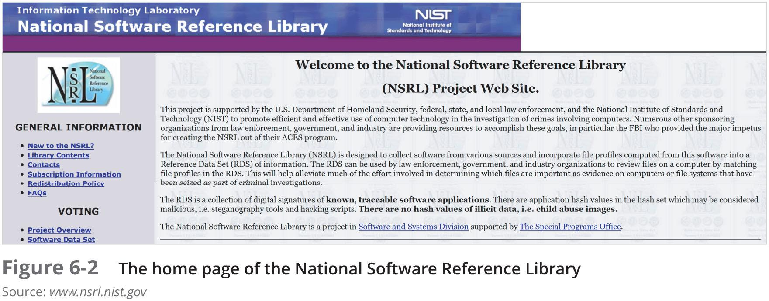
Tasks Performed by Digital Forensics Tools (8 of 20)

Slide 13
Tasks Performed by Digital Forensics Tools (9 of 20)
Validation and discrimination (cont’d)
Many computer forensics programs include a list of common header values
With this information, you can see whether a file extension is incorrect for the file type
Most forensics tools can identify header values

Slide 14
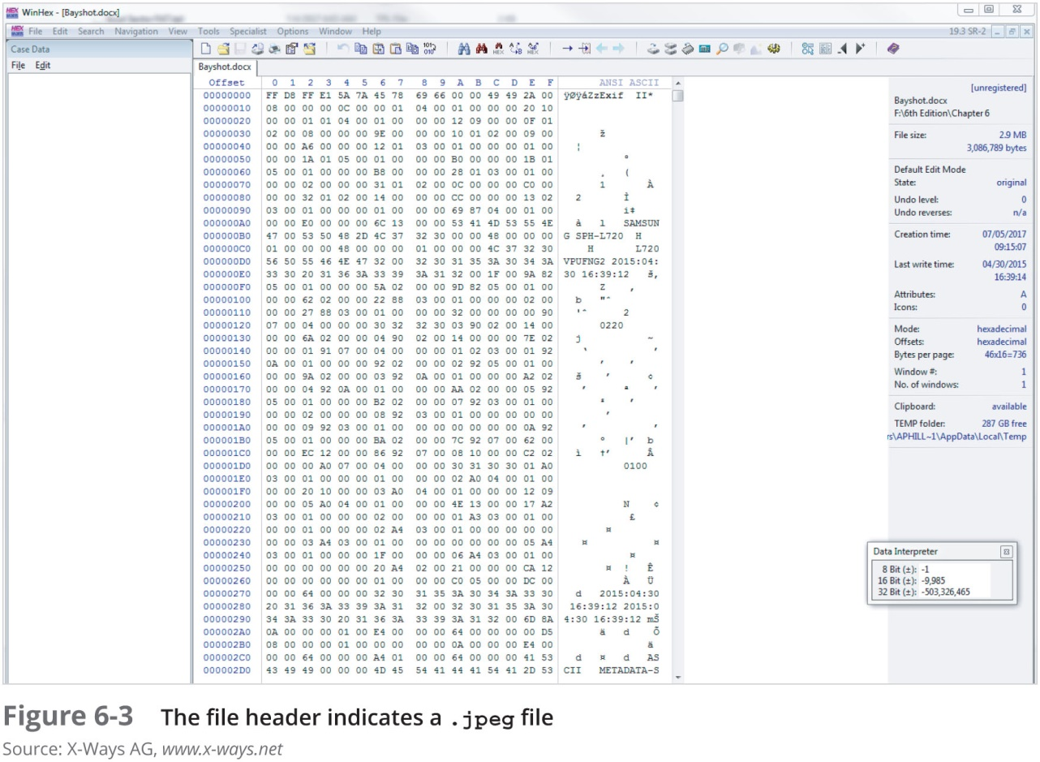
Tasks Performed by Digital Forensics Tools (10 of 20)

Slide 15
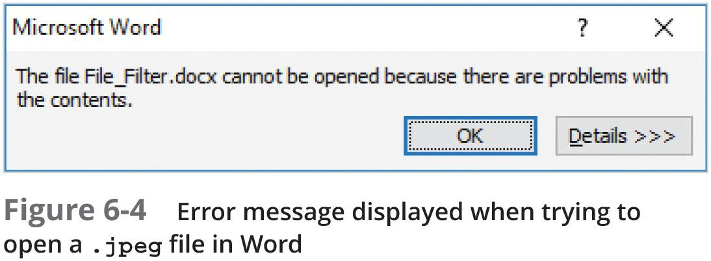
Tasks Performed by Digital Forensics Tools (11 of 20)

Slide 16
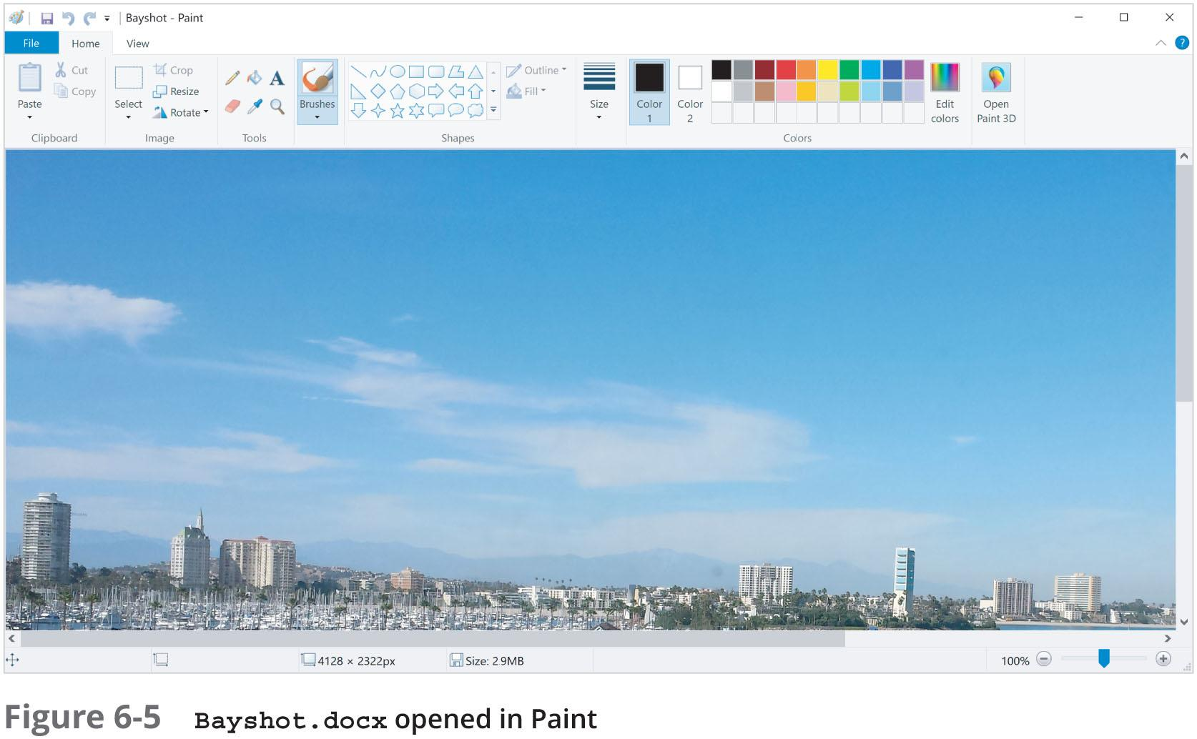
Tasks Performed by Digital Forensics Tools (12 of 20)

Slide 17
Tasks Performed by Digital Forensics Tools (13 of 20)
Extraction
Recovery task in a digital investigation
Most challenging of all tasks to master
Recovering data is the first step in analyzing an investigation’s data

Slide 18
Tasks Performed by Digital Forensics Tools (14 of 20)
Extraction (cont’d)
Subfunctions of extraction
Data viewing
Keyword searching
Decompressing or uncompressing
Carving
Decrypting
Bookmarking or tagging
Keyword search speeds up analysis for investigators

Slide 19
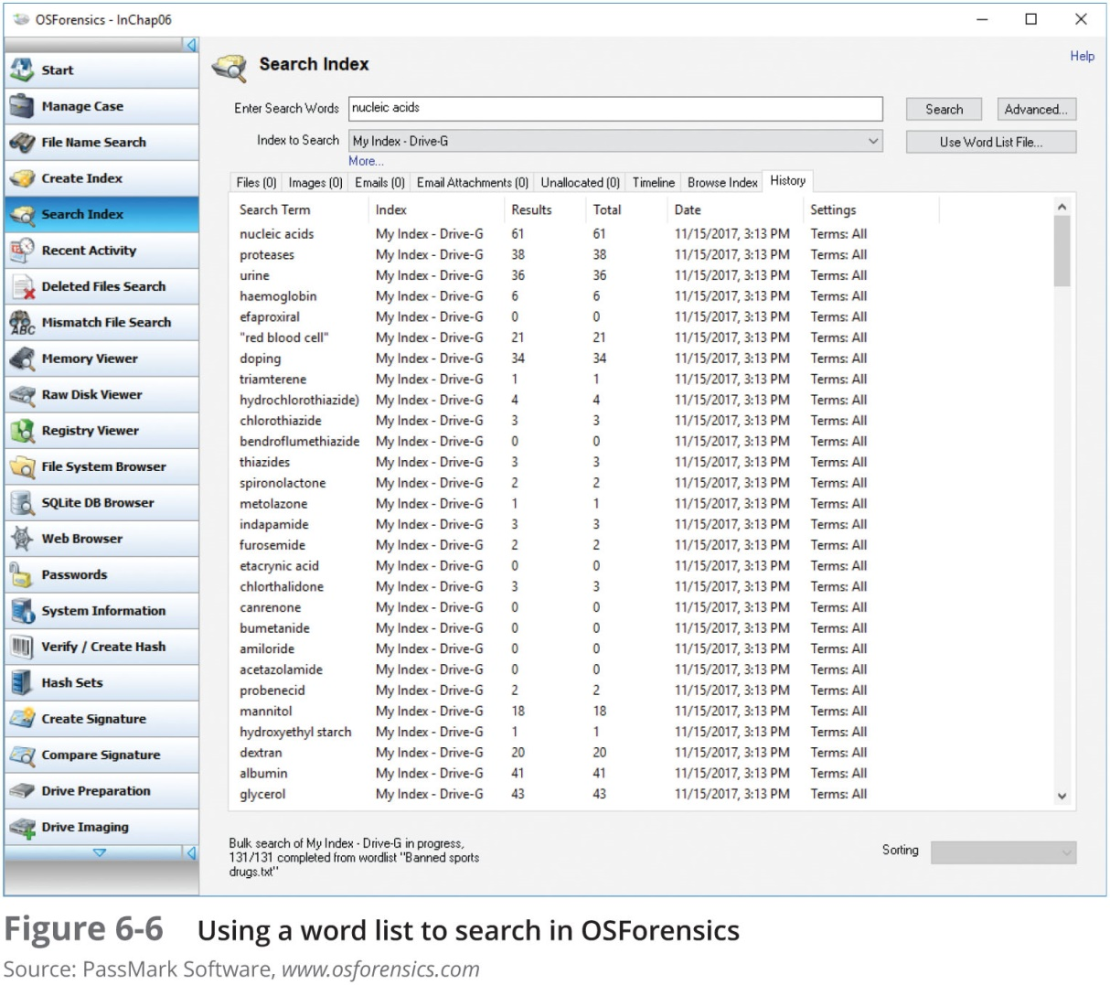
Tasks Performed by Digital Forensics Tools (15 of 20)

Slide 20
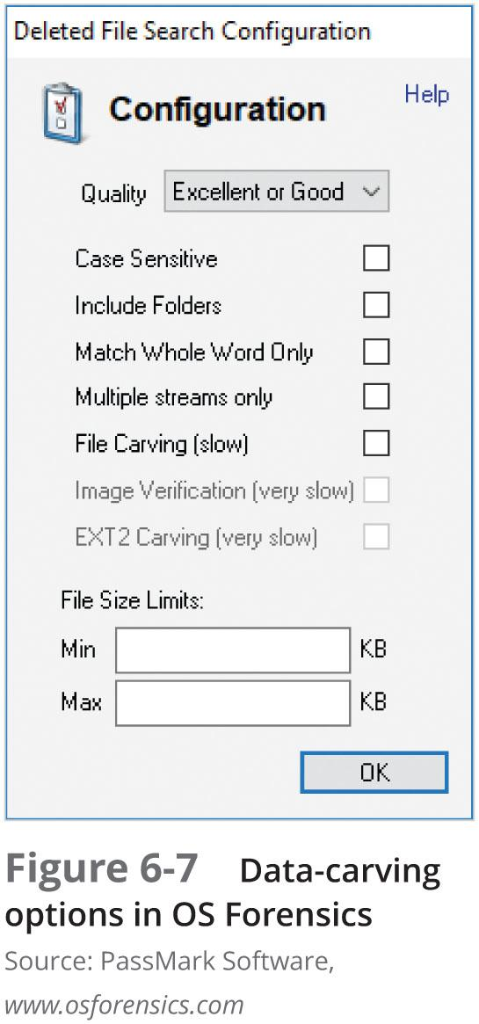
Tasks Performed by Digital Forensics Tools (16 of 20)

Slide 21
Tasks Performed by Digital Forensics Tools (17 of 20)
Extraction (cont’d)
From an investigation perspective, encrypted files and systems are a problem
Many password recovery tools have a feature for generating potential password lists
For a password dictionary attack
If a password dictionary attack fails, you can run a brute-force attack

Slide 22
Tasks Performed by Digital Forensics Tools (18 of 20)
Reconstruction
Re-create a suspect drive to show what happened during a crime or an incident
Methods of reconstruction
Disk-to-disk copy
Partition-to-partition copy
Image-to-disk copy
Image-to-partition copy
Disk-to-image copy
Rebuilding files from data runs and carving

Slide 23
Tasks Performed by Digital Forensics Tools (19 of 20)
Reconstruction (cont’d)
To re-create an image of a suspect drive
Copy an image to another location, such as a partition, a physical disk, or a virtual machine
Simplest method is to use a tool that makes a direct disk-to-image copy
Examples of disk-to-image copy tools:
Linux dd command
ProDiscover
Voom Technologies Shadow Drive

Slide 24
Tasks Performed by Digital Forensics Tools (20 of 20)
Reporting
To perform a forensics disk analysis and examination, you need to create a report
Subfunctions of reporting
Bookmarking or tagging
Log reports
Timelines
Report generator
Use this information when producing a final report for your investigation

Slide 25
Other Considerations for Tools
Considerations
Flexibility
Reliability
Future expandability
Create a software library containing older versions of forensics utilities, OSs, and other programs

Slide 26
Digital Forensics Software Tools
The following sections explore some options for command-line and GUI tools in both Windows and Linux

Slide 27
Command-line Forensics Tools
The first tools that analyzed and extracted data from floppy disks and hard disks were MS-DOS tools for IBM PC file systems
Norton DiskEdit
One of the first MS-DOS tools used for computer investigations
Command-line tools require few system resources
Designed to run in minimal configurations

Slide 28
Linux Forensics Tools (1 of 3)
UNIX has been mostly replaced by Linux
You might still encounter systems running UNIX
Linux platforms have become more popular with home and business end users
SMART
Designed to be installed on numerous Linux versions
Can analyze a variety of file systems with SMART
Many plug-in utilities are included with SMART
Another useful option in SMART is its hex viewer

Slide 29
Linux Forensics Tools (2 of 3)
Helix 3
One of the easiest suites to use
You can load it on a live Windows system
Loads as a bootable Linux OS from a cold boot
**Some international courts have not accepted live acquisitions as a valid forensics practice
Kali Linux
Formerly known as BackTrack
Includes a variety of tools and has an easy-to-use KDE interface

Slide 30
Linux Forensics Tools (3 of 3)
Autopsy and SleuthKit
Sleuth Kit is a Linux forensics tool
Autopsy was the browser interface used to access Sleuth Kit’s tools
Chapter 7 explains how to use these tools
Forcepoint Threat Protection
Formerly known as Second Look
A Linux memory analysis tool
Could perform both onsite and remote memory acquisitions

Slide 31
Other GUI Forensics Tools (1 of 2)
GUI forensics tools can simplify digital forensics investigations
Have also simplified training for beginning examiners
Most of them are put together as suites of tools
Advantages
Ease of use
Multitasking
No need for learning older OSs

Slide 32
Other GUI Forensics Tools (2 of 2)
Disadvantages
Excessive resource requirements
Produce inconsistent results
Create tool dependencies
Investigators’ may want to use only one tool
Should be familiar with more than one type of tool

Slide 33
Digital Forensics Hardware Tools
Technology changes rapidly
Hardware eventually fails
Schedule equipment replacements periodically
When planning your budget consider:
Amount of time you expect the forensic workstation to be running
Failures
Consultant and vendor fees
Anticipate equipment replacement

Slide 34
Forensic Workstations (1 of 4)
Carefully consider what you need
Categories
Stationary workstation
Portable workstation
Lightweight workstation
Balance what you need and what your system can handle
Remember that RAM and storage need updating as technology advances

Slide 35
Forensic Workstations (2 of 4)
Police agency labs
Need many options
Use several PC configurations
Keep a hardware library in addition to your software library
Private corporation labs
Handle only system types used in the organization

Slide 36
Forensic Workstations (3 of 4)
Building a forensic workstation is not as difficult as it sounds
Advantages
Customized to your needs
Save money
Disadvantages
Hard to find support for problems
Can become expensive if careless
Also need to identify what you intend to analyze

Slide 37
Forensic Workstations (4 of 4)
Some vendors offer workstations designed for digital forensics
Examples
F.R.E.D. unit from Digital Intelligence
Hardware mounts from ForensicPC
Having vendor support can save you time and frustration when you have problems
Can mix and match components to get the capabilities you need for your forensic workstation

Slide 38
Using a Write-Blocker (1 of 2)
Write-blocker
Prevents data writes to a hard disk
Software-enabled blockers
Typically run in a shell mode (Windows CLI)
Example: PDBlock from Digital Intelligence
Hardware options
Ideal for GUI forensic tools
Act as a bridge between the suspect drive and the forensic workstation

Slide 39
Using a Write-Blocker (2 of 2)
You can navigate to the blocked drive with any application
Discards the written data
For the OS the data copy is successful
Connecting technologies
FireWire
USB 2.0 and 3.0
SATA, PATA, and SCSI controllers

Slide 40
Recommendations for a Forensic Workstation (1 of 3)
Determine where data acquisitions will take place
With Firewire and USB write-blocking devices
You can acquire data easily with Digital Intelligence FireChief and a laptop computer
If you want to reduce hardware to carry:
WiebeTech Forensic DriveDock with its regular DriveDock FireWire bridge or the Logicube Talon

Slide 41
Recommendations for a Forensic Workstation (2 of 3)
Recommendations when choosing stationary or lightweight workstation:
Full tower to allow for expansion devices
As much memory and processor power as budget allows
Different sizes of hard drives
400-watt or better power supply with battery backup
External FireWire and USB ports
Assortment of drive adapter bridges

Slide 42
Recommendations for a Forensic Workstation (3 of 3)
Recommendations when choosing stationary or lightweight workstation (cont’d):
Ergonomic keyboard and mouse
A good video card with at least a 17-inch monitor
High-end video card and dual monitors
If you have a limited budget, one option for outfitting your lab is to use high-end game PCs

Slide 43
Validating and Testing Forensic Software
It is important to make sure the evidence you recover and analyze can be admitted in court
You must test and validate your software to prevent damaging the evidence

Slide 44
Using National Institute of Standards and Technology Tools (1 of 3)
NIST publishes articles, provides tools, and creates procedures for testing/validating forensics software
Computer Forensics Tool Testing (CFTT) project
Manages research on forensics tools
NIST has created criteria for testing forensics tools based on:
Standard testing methods
ISO 17025 criteria for testing items that have no current standards

Slide 45
Using National Institute of Standards and Technology Tools (2 of 3)
Your lab must meet the following criteria
Establish categories for digital forensics tools
Identify forensics category requirements
Develop test assertions
Identify test cases
Establish a test method
Report test results
ISO 5725 - specifies results must be repeatable and reproducible

Slide 46
Using National Institute of Standards and Technology Tools (3 of 3)
NIST created the National Software Reference Library (NSRL) project
Collects all known hash values for commercial software applications and OS files
Uses SHA-1 to generate a known set of digital signatures called the Reference Data Set (RDS)
Helps filtering known information
Can use RDS to locate and identify known bad files

Slide 47
Using Validation Protocols (1 of 3)
Always verify your results by performing the same tasks with other similar forensics tools
Use at least two tools
Retrieving and examination
Verification
Understand how forensics tools work
One way to compare results and verify a new tool is by using a disk editor
Such as Hex Workshop or WinHex

Slide 48
Using Validation Protocols (2 of 3)
Disk editors do not have a flashy interface, however they:
Are reliable tools
Can access raw data
Digital Forensics Examination Protocol
Perform the investigation with a GUI tool
Verify your results with a disk editor
Compare hash values obtained with both tools

Slide 49
Using Validation Protocols (3 of 3)
Digital Forensics Tool Upgrade Protocol
Test
New releases
OS patches and upgrades
If you find a problem, report it to forensics tool vendor
Do not use the forensics tool until the problem has been fixed
Use a test hard disk for validation purposes
Check the Web for new editions, updates, patches, and validation tests for your tools

Slide 50
Summary (1 of 3)
Consult your business plan to get the best hardware and software
Computer forensics tools functions
Acquisition
Validation and verification
Extraction
Reconstruction
Reporting
Maintain a software library on your lab

Slide 51
Summary (2 of 3)
Computer Forensics tools types
Software
Hardware
Forensics software
Command-line
GUI
Forensics hardware
Customized equipment
Commercial options
Include workstations and write-blockers

Slide 52
Summary (3 of 3)
Tools that run in Windows and other GUI environments don’t require the same level of computing expertise as command-line tools
Always run a validation test when upgrading your forensics tools

Slide 53
Thank You!
Next chapter:
Foundation for forensics

Slide 54
No. | Title of the Module
M1 | Introduction to Cyber Crime, Digital Forensics and Incident Handling
M2 | Foundation for Forensics
M3 | Computer Crime and Identity Theft/Fraud
M4 | Digital Forensic Process, Analysis and Validation
M5 | Disk Structures (File Systems) and Data-hiding techniques
M6 | Network and Cloud Forensics; Mobile Device and Security
M7 | Digital Forensic Tools and Labs
M8 | Organizations and Cyber Crime, Criminology and Organized Crime
M9 | Investigating Internet Crime and E-Mail Crime
M10 | Cyberspace Infrastructure and Enterprise Security
M11 | Incident Detection and Characterization
M12 | Incident Response and software Tools
M13 | Incident Report Writing
M14 | Emerging Cybercrime Trends, Recommendations and Practical Issues
M15 | Miscellaneous Topics

